Slide 1


Lab 3: Healthcare Scenario
Paul Robles

Slide 2
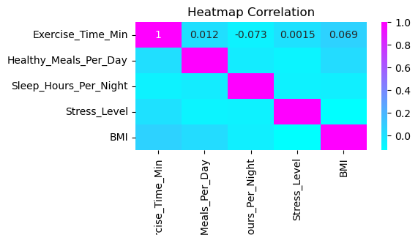
Heat Map Correlation

Slide 3
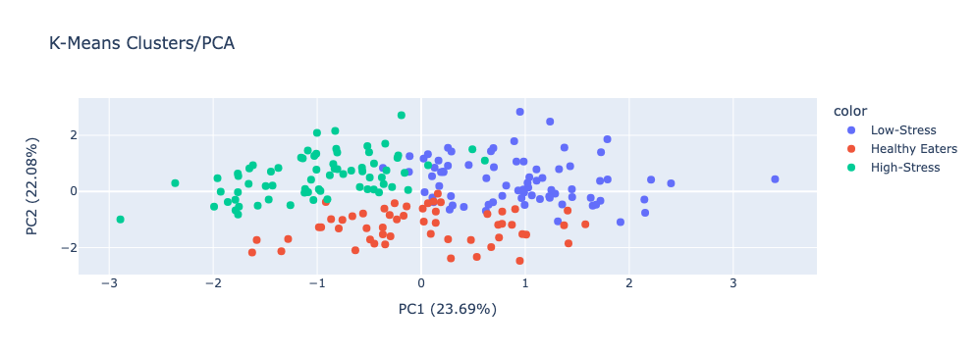
Plotted Data

